Slide 1
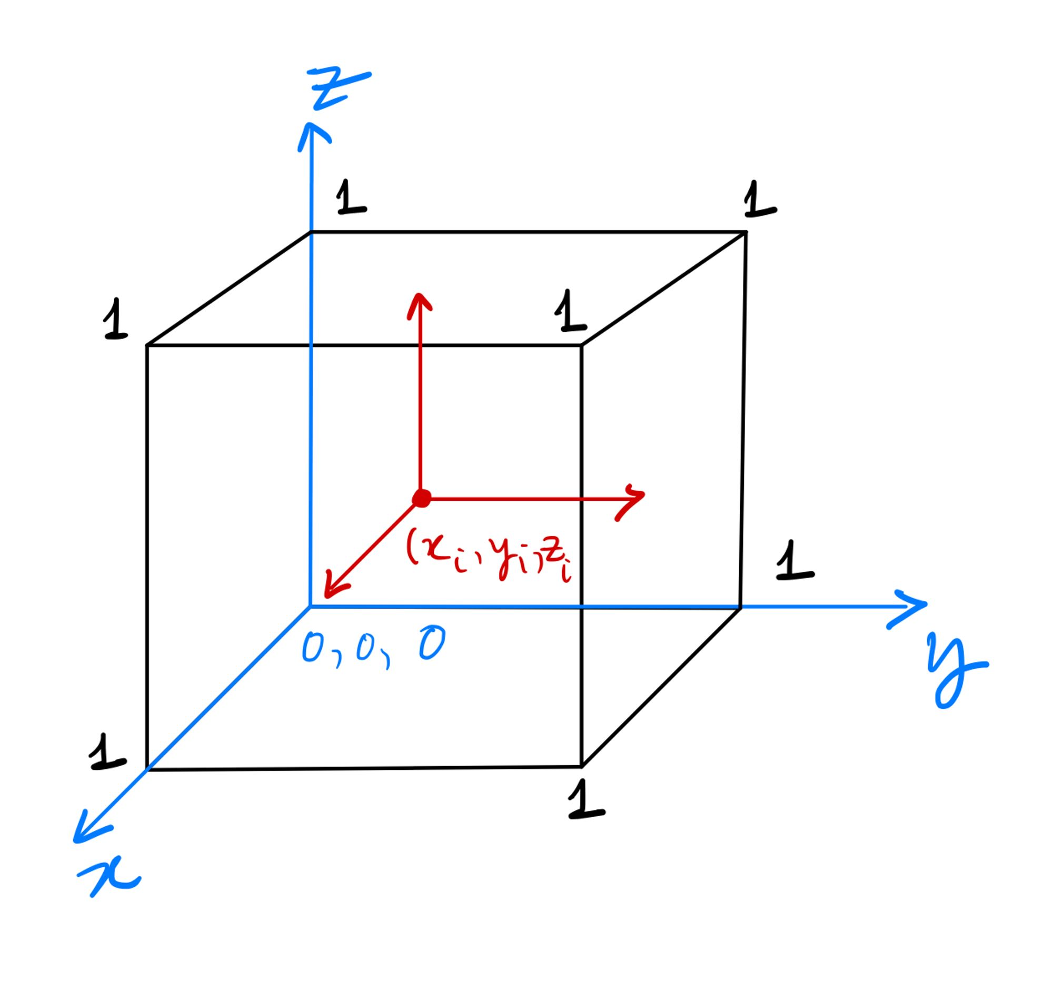
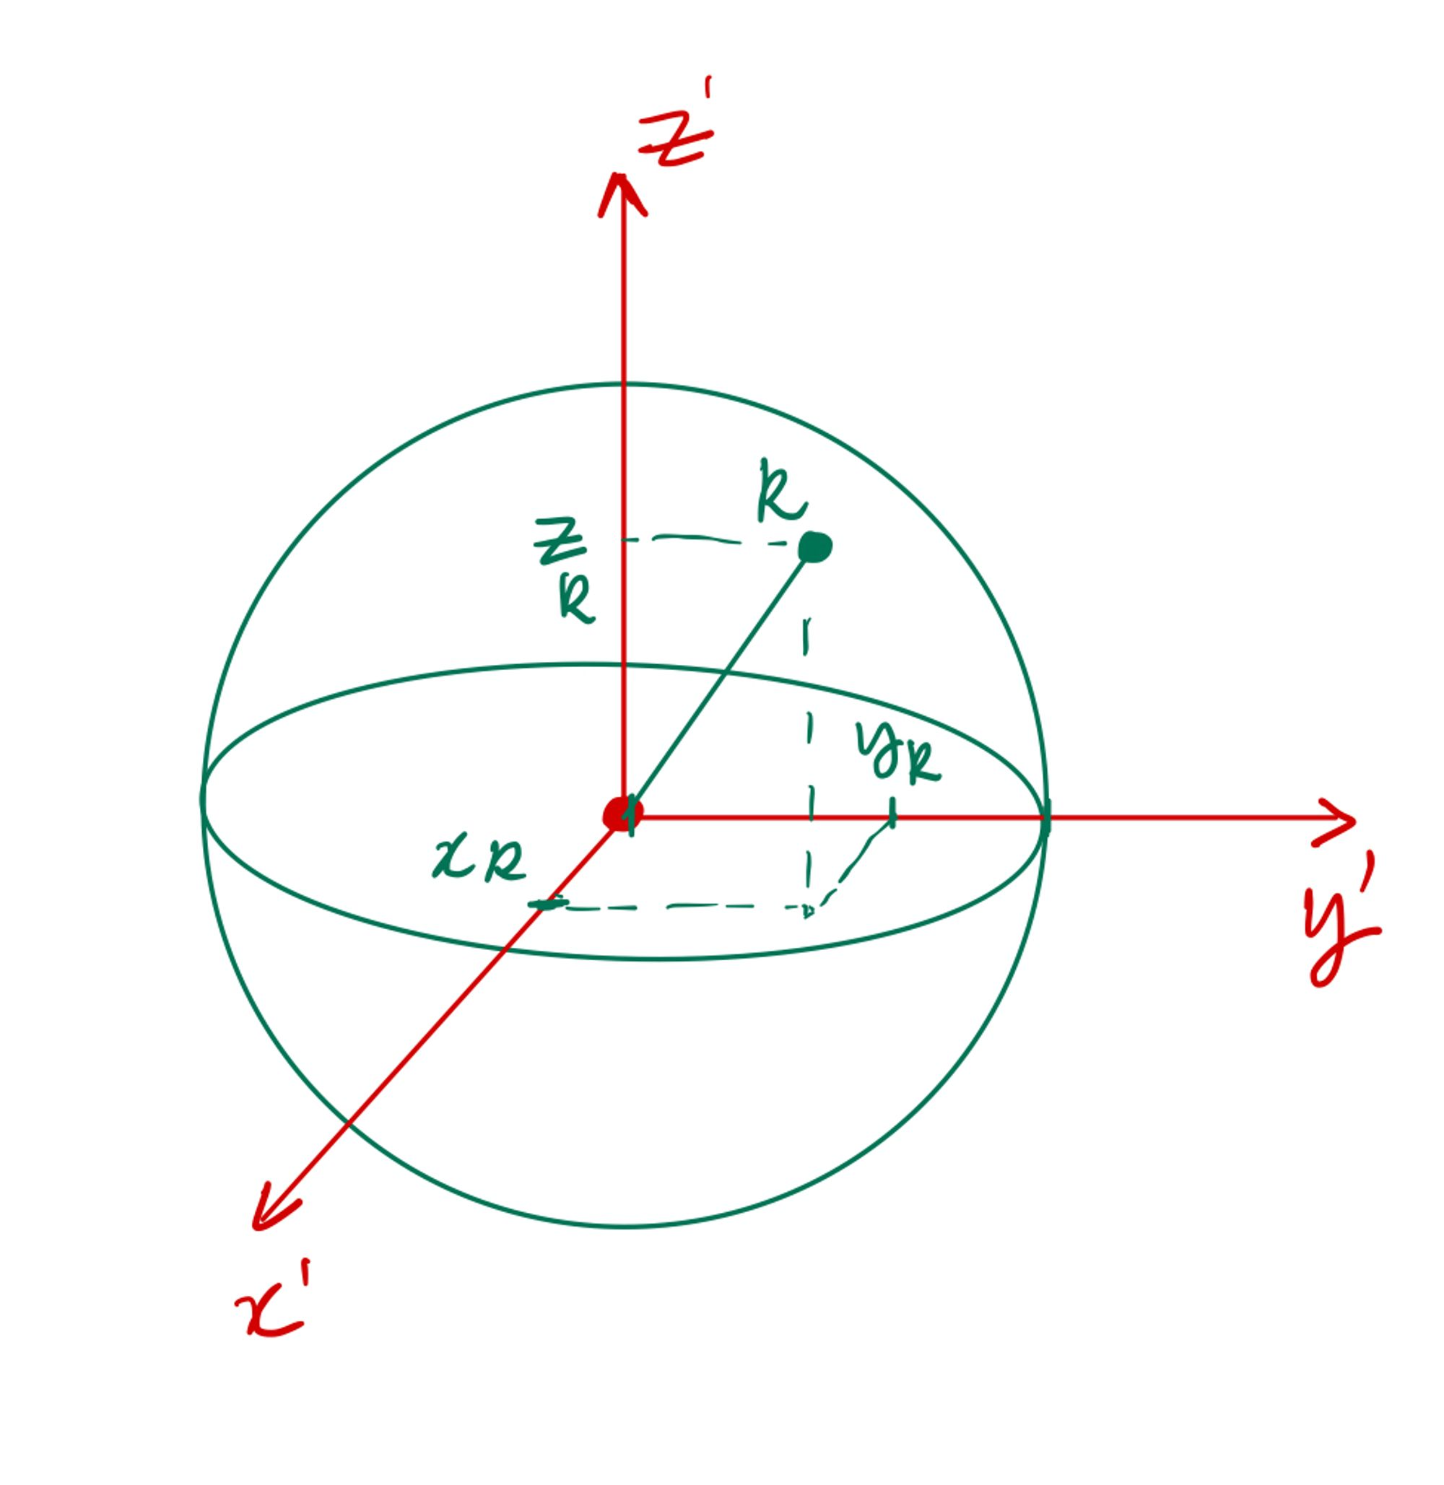
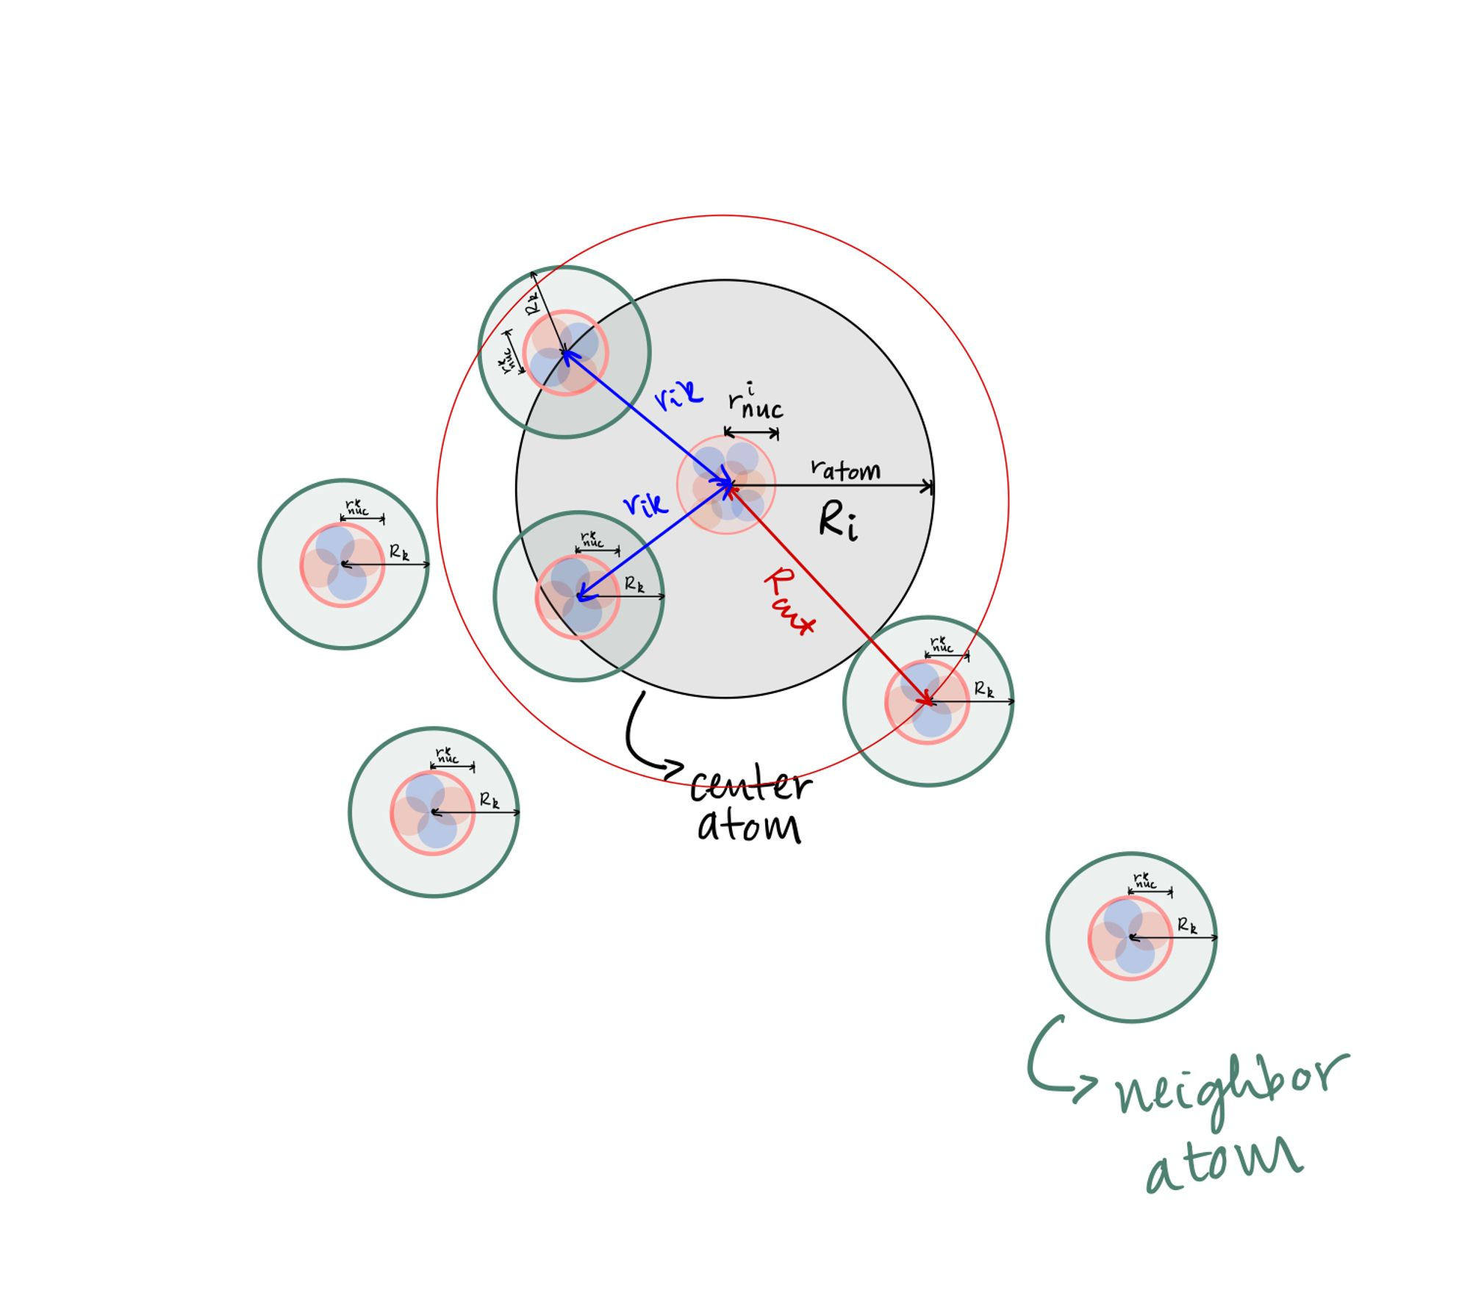
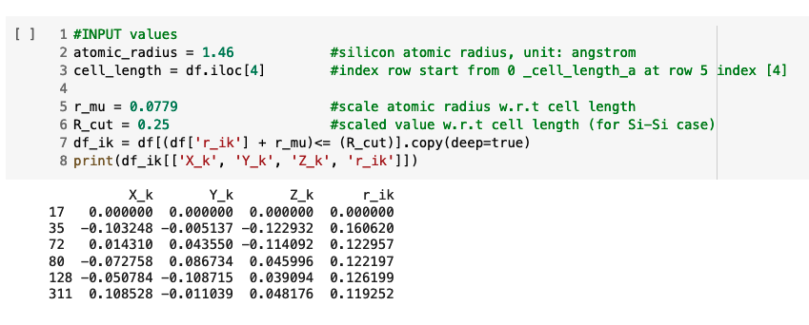
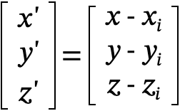
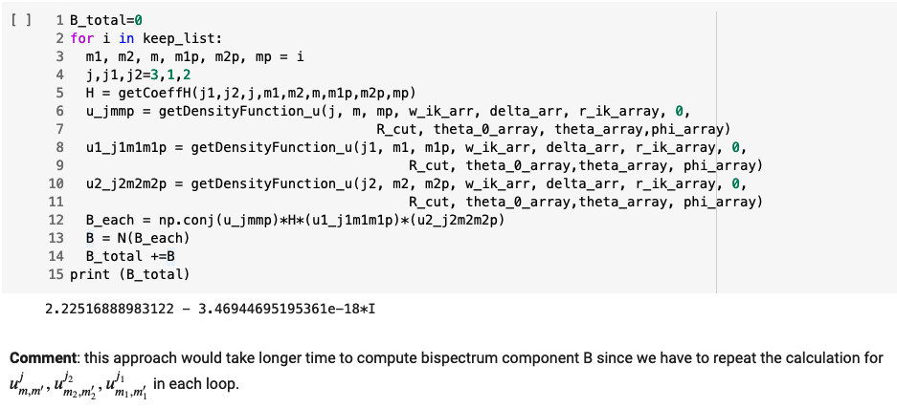
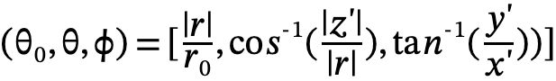
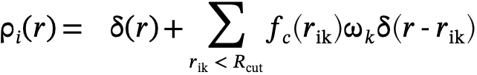
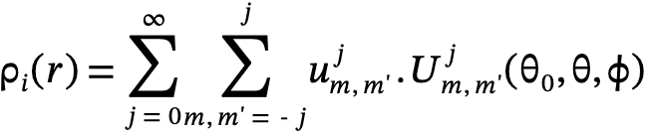
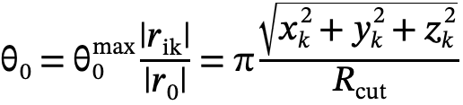
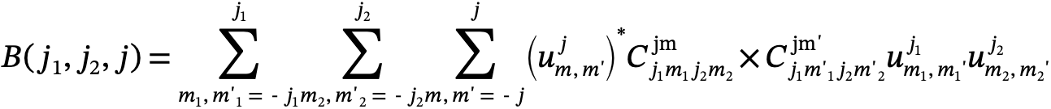
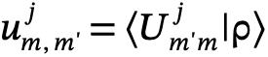
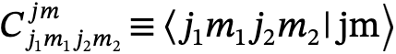
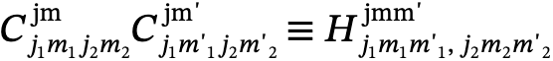
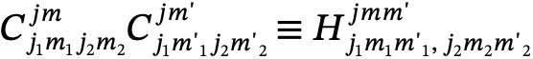
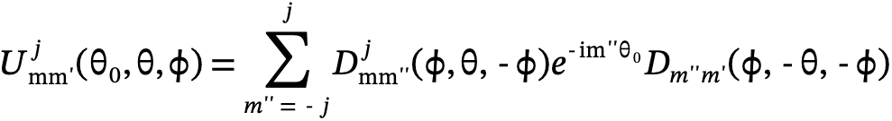
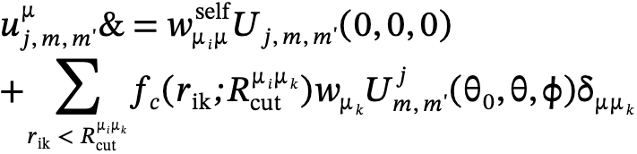
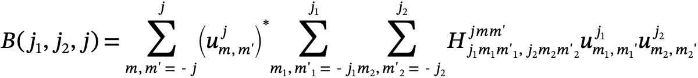
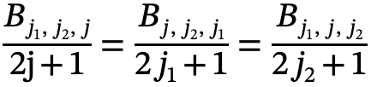
Automated Bispectrum Component Computation with Python
Duong Hoang
Division of Energy, Matter, and Systems at the University of Missouri – Kansas City
Introduction
Methods
Preliminary Results
My research involves the development of a Python script to automatically calculate bispectrum components and implement them in the Orthogonalized Linear Combination of Atomic Orbitals (OLCAO) package. While other methods such as neural networks and graph neural networks have also shown promise in predicting material properties, bispectrum components are a useful and promising tool that can capture subtle variations in the local atomic environment that are difficult to predict using some other methods.
By incorporating bispectrum components into machine learning frameworks, my research aims to more accurately predict material properties and electronic structures influenced by nearby atoms. However, the effectiveness of machine learning frameworks depends on many factors, including the quality of the training data, the choice of algorithm, and the specific problem being addressed. Therefore, my work will contribute to the ongoing effort to develop new and improved machine learning frameworks for predicting electronic structure materials with desirable properties, and ultimately advance the field of material science research.
To evaluate the significance of my research, I will provide specific details about the results and potential impact in future publications and presentations.
Data preparation
Bispectrum calculation :
Define the coordinates (x', y', z') of the neighbor atoms with respect to the center atom's frame of reference.
(a) (b) (c )
Figure 2. (a) Coordinate transformation, shift origin O to center atom i location, (b) Define position of a neighbor atom k relative to a central atom i is a point within the 3D ball of radius, (c ) Visualize cut off region around center atom i
Background
Idea: project the neighbor atoms on to the surface of four- dimensional unit sphere, similarly to how the Riemann sphere is constructed with the transformation
Local density neighbor function in 3D/ 4D dimensional space
3D | 4D
Bispectrum - S(O)4
Framework for Bispectrum Calculation
The atomic environment descriptor proposed by Bartok et al [3], that have real value and remain invariant under translation, rotation, and permutation of atoms:
Define input parameters
Data preparation
New Python scripts have been developed to calculate:
Clebsch-Gordan Coefficients
Wigner-D functions
Rotational Matrix U
Expansion coefficient density function
with optimized running times that do not require the use of third-party libraries such as SymPy. Our custom functions exhibits faster running times than SymPy's implementation
Equation | Definition
 | Density coefficient function relates to the probability density of atoms' orientations in the material
 | Clebsch Gordan coefficient, represent the probability amplitude that j1 and j2 are coupled into a resultant angular momentum j with projection m.
 | Coupling coefficients in four-dimensional spherical harmonic, analogous to the Clebsch-Gordan coefficients for rotations in two dimensions.
Generate possible m values from input
Discussion
Understanding the relationship between quantum numbers and the density coefficient function is crucial for accurately describing particle behavior in higher-dimensional space. The expansion density function (u) is particularly essential for calculating the bispectrum component since it relates to the probability density of atoms' orientations in the material. However, interpreting the expansion density function accurately can be challenging due to our incomplete understanding of hyper-spherical harmonics. This lack of understanding can limit the development of methods to predict the material's behavior based on the bispectrum, underscoring the urgent need for further research in this area to realize the full potential of the hyper-spherical harmonic expansion of density function.
One challenge in this research is defining a suitable cut-off radius for the cut-off function to avoid neglecting the interaction between the center atom and its defined neighbor. The bispectrum also depends on the (j,j1,j2) values for the expansion, and it is crucial to understand this band limit and undertake further study. By doing so, we can gain a better understanding of the behavior of materials in higher-dimensional space and develop more accurate predictive models.
Coupling Coefficient
Rotational Matrix U via Wigner D function
Table 1. Mathematical equations for bispectrum calculation
Systems
Expansion coefficients density function
Future Work
Unit cell of a morphic silicon
Number of atoms = 340
Atom site type : Si
The material has a primitive lattice with no symmetry elements in its crystal structure.
Number of atom in the cell: 340
Cell length (a, b, c) = (18.7337, 18.7337, 18.7337)
Cell angle (𝛂, 𝛽, 𝞬) = (90, 90, 90)
Atom site type : Si
Atoms coordinate x, y, z site fraction
Code optimization: Bispectrum Class Function
Visualize relationship between bispectum component and band limit (j,j1,j2)
Study expansion density function in hyper-spherical harmonic
Campare bispectrum to other descriptors for input training:
Atom-centered Symmetry Functions (ACSFs): descriptor of the local environment of each atom, these models can capture the complex relationships between the atomic positions and the electronic structure of the molecule, leading to accurate predictions of electronic properties.
Coulomb matrix eigenvalues (CMEs)
Bag of bond
Bispectrum component for a chosen center atom
References
Figure 1. Unit cell of a morphic silicon,
VESTA visualization
Test accuracy
[1]Thompson, A. P., Swiler, L. P., Trott, C. R., Foiles, S. M., & Tucker, G. J. (2015). Spectral neighbor analysis method for automated generation of quantum-accurate interatomic potentials. https://www.osti.gov/biblio/1426894
Copyright © 2023 UMKC
Work supported by Dr. Rulis
Contact us at: rulisp@umkc.edu , dtht2d@umsystem.edu

